Slide 1
Introduction to Crypto
1
Money, Stablecoins and CBDC
Kathryn Zhao

Slide 2
Introduction to Crypto
2
Current State of Affairs: Traditional Finance (TradFi)
1. Not universally accessible
High entry barriers, KYC
5% of U.S. adults in the bottom 40% of the income distribution are unbanked
Situation is worse outside 1st world countries
2. Expensive
Explicit and hidden banking fees
Credit associated fees and penalties
Particularly high for lower income people: in the US, Low-income account holders pay more than $12 a month for basic access to the financial system

Slide 3
Introduction to Crypto
3
Current State of Affairs (continued)
3. Technologically complex
Proprietary legacy protocols
Slow: natural throughput limitations
4. Other considerations
Cross-border payments: slow and expensive
Exchange rate inefficiencies

Slide 4
Introduction to Crypto
4
Current State of Affairs (continued)
TradFi is controlled and operated by a relatively small number of third-party intermediaries that facilitate financial transactions using their closed networks, like Visa, SWIFT, etc.
This makes them expensive but also prevents innovation, keeping throughput low and costly
Issues with accessibility, efficiency and cost are in large part because of centralized control
Does money have to be centralized?

Slide 5
Introduction to Crypto
5
Private Money
1. Not controlled by any centralized entity
Centralized entities are prone to manipulate both accessibility and the value of public money they control in their own interest
2. Clear definition of value:
How is the value of a unit of the currency determined?
3. Trustless
No need to trust anyone to maintain the value of money
Government intervention in the system has led to instability and inflation

Slide 6
Introduction to Crypto
6
Private Money (continued)
Free Banking Era (1837 – 1866): almost anyone could issue paper money
Friedrich Hayek “The Denationalization of Money,” (1976): allowing private currencies to compete would create a more stable monetary system
Government intervention leads to instability and inflation
Value determined by supply and demand
Multiple competing moneys: competition creates a more stable monetary system, leads to improvements in technology, costs
Early attempt to create private money were largely unsuccessful
2007, founder of The United Cities Corporation indicted on one count of conspiracy to defraud the United States.

Slide 7
Introduction to Crypto
7
What do we need from money?
1. Wide availability
Access to financial services for underbanked
2. Low to no cost
3. Transparency
No fraud is possible, everything is auditable
4. Value clearly defined through well-known mechanism
Laws of supply and demand
Backing by some “real asset”
Satoshi proposed the concept of Bitcoin based on public distributed ledger!

Slide 8
Introduction to Crypto
8
What can blockchains offer?
Availability
Transparency
All transactions are public
3. Speed (relative)
4. Security (immutability)
5. Just need to add a solution to the value question

Slide 9
Introduction to Crypto
9
Enter stablecoins
1. Digital Assets (cryptocurrency)
2. Designed to maintain a stable value
In relation to a specific asset, in most cases, a reserve of fiat currency, such as USD or EUR
Like DeFi →
Independent, transparent, low cost, fast, and easily accessible
Like TradFi →
Low volatility
Familiarity?

Slide 10
Introduction to Crypto
10
Enter stablecoins (continued)
Essential properties of any fiat money
1. Medium of exchange
2. Store of value
3. Units of account
In addition
1. Backed by and redeemable for real assets (not any entity’s “promise” or guarantee)
2. Interoperability

Slide 11
Introduction to Crypto
11
What are stablecoins, really?
Cryptocurrencies
Tokens on existing blockchains
Can exist on multiple chain at the same time! Important to avoid chain dependency
All about adoption, not specific technology
2. Software (open code) regulates their issuance and lifecycle
Value is governed by logic implemented by smart contracts
Code is law, logic is open!
Therefore, no questions of trust

Slide 12
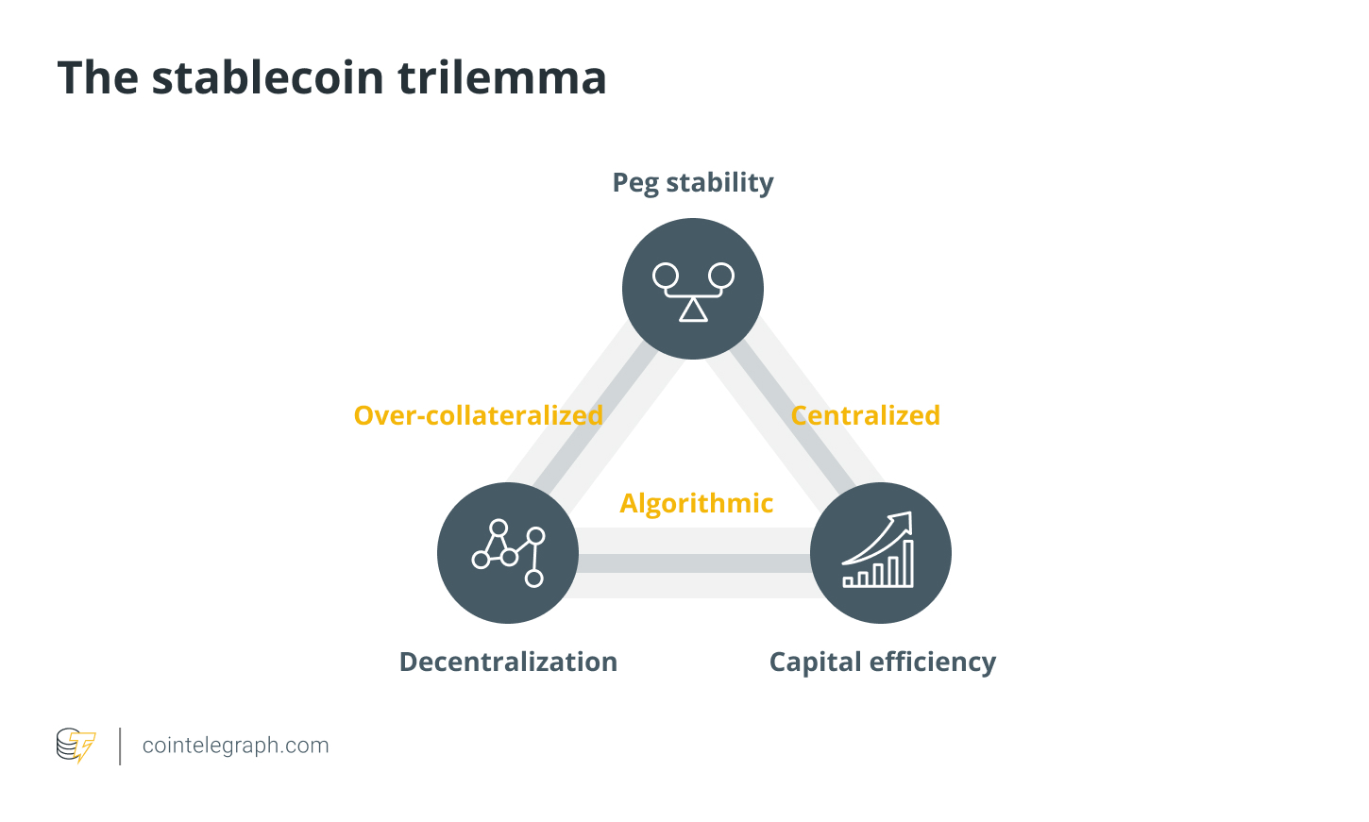
Introduction to Crypto
12
Source:

Slide 13
Introduction to Crypto
13
Trilemma: three properties of stablecoins at odds with each other
Capital efficiency
Capital requirements to create and maintain the coin value (the cost of capital)
Stability (volatility)
How far the unit value deviates from the reference unit
Close tracking for the currency to perform its intended functions
Decentralization
How many network participants are “in control” and how easy it is to join
High level of decentralization: no need to trust a central authority

Slide 14
Introduction to Crypto
14
Fiat-collateralized stablecoins
These stablecoins are backed by a reserve of fiat currency, such as USD, EUR, or JPY. Examples: Tether (USDT), with 1:1 peg against the US dollar
1. Deposit
Users deposit a specific amount of fiat currency (e.g. USD) into a bank account managed by the stablecoin issuer
2. Issuance
The stablecoin issuer mints (creates on-chain) an equivalent amount of stablecoins (e.g., USDT) and distributes them to the users
3. Redemption
Users return coins to the issuer, who then destroys them and releases the corresponding amount of fiat currency back to the users

Slide 15
Introduction to Crypto
15
Fiat-collateralized stablecoins (continued)
Benefits:
Fiat-backed stablecoin structure is simple
Fiat is considered stable, which ensures low volatility
Disadvantages:
Comes with counterparty risk: the need to trust the issuer of coins and the centralized organization holding the reserves
Lack of regulations and the need of independent audits
Offer high levels of capital efficiency and stability
But managed by a central entity: relies on trust in the custodian holding the reserves

Slide 16
Introduction to Crypto
16
Crypto-collateralized stablecoins
Backed by a basket of other cryptocurrencies
Examples: MakerDAO’s DAI backed by various cryptos including Ether
1. Deposit
User locks up a certain amount of crypto (e.g., ETH) as collateral in a smart contract
2. Issuance
Smart contract mints the stablecoin (e.g., DAI) and sends it to the user
The amount of stablecoin issued is less than the value of the collateral to account for potential price fluctuations
3. Redemption
Users can redeem their collateral by repaying the stablecoin debt, plus any accrued interest or fees. The smart contract then releases the collateral back to the user and burns (destroys) the returned stablecoin units

Slide 17
Introduction to Crypto
17
Crypto-collateralized stablecoins (continued)
Benefits:
Truly decentralized, as it is based on a blockchain
Doesn't require a custodian
No regulations or audits required
Disadvantages:
Crypto backed stablecoin's structure is more complex
Must be over-collateralized to mitigate dependency on the collateral volatility
Offer stability, decentralization
Not capital efficient: require higher levels of collateral assets

Slide 18
Introduction to Crypto
18
Algorithmic stablecoins
No association with collateral: algorithms maintain the peg. They adjust the supply of the stablecoin in response to changes in demand, like how central banks manage money supply. Algorithms run on a blockchain in the form of smart contracts.
Examples: AMPL
1. Price Discovery
Smart contract monitors the market price, comparing it to the target price
2. Supply Adjustment
If the market price deviates from the target, smart contract automatically adjusts the stablecoin supply through minting or burning (“rebasing”)
This incentivizes users to buy or sell the stablecoin to restore its value

Slide 19
Introduction to Crypto
19
Algorithmic stablecoins (continued)
Benefits:
No collateral is required, so extremely capital-efficient
Fully automated decentralized and trustless system, independent from any central authority action (in theory)
Disadvantages:
Complex implementation: often requires a separate governance coin (seigniorage); hard to understand for average investors and consumers
Relies on its own future demand, and demand is not always guaranteed
Offer high level of decentralization and capital efficiency
Little stability guarantees via complex logic that fails in extreme cases

Slide 20
Introduction to Crypto
20
Commodity-backed stablecoins
Backed by a reserve of commodities: gold, real estate, or oil. The underlying asset is often stored in a vault of a trusted third party. Coins redeemed with the commodity.
Examples: PAX Gold (PAXG), backed by physical gold
Benefits:
Real assets back each commodity-collateralized stablecoin
Commodities prices are relatively stable
Commodities tokenization brings more liquidity to the market
Disadvantages:
Centralized
Must undergo an audit process to ensure its authenticity

Slide 21
Introduction to Crypto
21
Example: USDT
The most popular, wide-spread stablecoin project, managed by Tether
Backed by long and short term US Treasuries as collateral
Generate passive income from these bonds
Available on many different blockchains: Bitcoin, Ethereum, Tron, Solana, Polygon, etc.
Can blacklist addresses and block transactions
Tether started publishing its reserve data in real time in 2024

Slide 22
Introduction to Crypto
22
Example: USDC
Backed by long and short term US Treasuries as collateral
Generate passive income from these bonds, which is the basis of their business model.
Debuted on Ethereum, but now available on many different blockchains: Solana, Cosmos, TRON, Algorand, etc.
Collateral is audited regularly. Strives to be more compliant
Can blacklist addresses
Interoperability: Cross-Chain Transfer Protocol. The coin is natively supported on multiple chains. When transferred, it is burned on the source chain and minted on the destination chain (no bridges)

Slide 23
Introduction to Stablecoin
23
UST (based on Terra protocol)
Dual-token system:
Stablecoin itself like TerraUSD (UST) and the governance token LUNA
Demand for UST high, price > $1:
Burn LUNA / mint some UST, increasing supply
Demand for UST low, price < $1:
Buy UST and burn it in exchange for LUNA which is exchanged for $1. Increased demand and decreases supply pushes the price back up, in theory
All depends on the protocol adoption for market players to be involved!

Slide 24
Introduction to Crypto
24
Stablecoin Depegging
What happens when stablecoins drift away from their peg?
Depegging introduces a layer of volatility and trading opportunities that are unique to the cryptocurrency landscape
A depegging is characterized by a significant deviation of a stablecoin from its normally pegged value
An example of depegging event is when USDT is trading at $0.95 while USDC is at $1.01. This divergence represents a depegging event between the two stablecoins

Slide 25
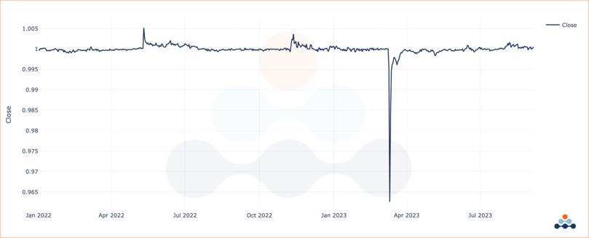
Introduction to Crypto
25
Stablecoin Depegging (continued):

Slide 26
Introduction to Crypto
26
Why does depegging occur?
Reserve Inadequacy: If traders start doubting the sufficiency of a stablecoin's reserve, they may start selling off, causing a depeg
Algorithmic Failures: For algorithmic stablecoins, bugs or exploits in the smart contract can lead to depegging events
Market Liquidity: A sudden surge in demand or supply can overwhelm the mechanisms keeping the coin stable, particularly if there is not enough liquidity in the market to absorb these shocks
Regulatory News: Announcements of regulatory scrutiny can trigger panic selling, temporarily causing a stablecoin to lose its peg
Macro-Economic Factors: Although less common, larger economic trends can also lead to a stablecoin deviating from its peg

Slide 27
Introduction to Crypto
27
Stablecoin use cases
Remittances / Cross-border transactions Cheaper and faster cross-border transactions compared to traditional banking systems: no fees and delays of wire transfers. For example, Ethereum-based token is available to PayPal users in the U.S.
Payment solutions for everyday transactions
Stability makes them an attractive option for merchants and consumers
Decentralized finance (DeFi) Provide liquidity for various lending, borrowing, and trading platforms. They can also serve as collateral for loans or be used to earn interest through yield farming

Slide 28
Introduction to Crypto
28
Stablecoins Can Make The World A Safer Place
“Herstatt” risk: synonymous with foreign exchange settlement risk
Basel Committee sets the regulatory capital standards
The $7.5 trillion a day global FX markets
Many currencies still take as long as two days to settle
Breakthroughs in technology have the potential to banish settlement risk to a thing of the past
Stablecoins can now reduce currency settlement latency from days to seconds
Properly regulated and backed by quality reserves, stablecoins — with their instant and simultaneous settlement on blockchains — reduce counterparty risk

Slide 29
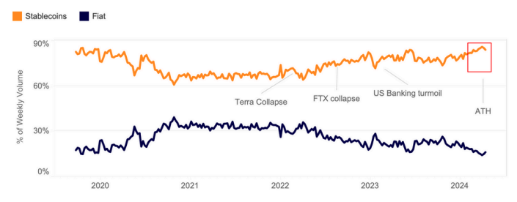
Introduction to Crypto
29
Stablecoin vs. Fiat

Slide 30
Introduction to Crypto
Stablecoin’s Evolving Landscape
The aggregate market cap of the stablecoin sector, which includes hundreds of coins, jumped to over $164 billion for the first time since the collapse of Terra in May 2022
The expansion indicates growing investor optimism, underpinning a bullish outlook
Money is being deposited into on-chain ecosystem to generate economic activity, either through direct on-chain purchases that can catalyze price appreciation or yield-generation strategies that could improve market liquidity

Slide 31
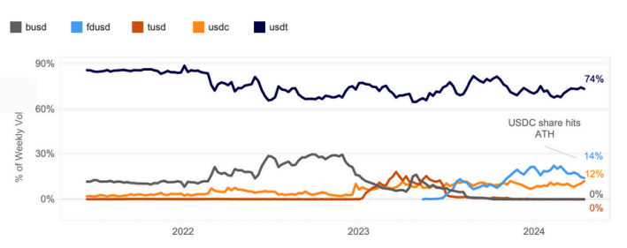
Introduction to Crypto
31
Stablecoins’ Market Share

Slide 32
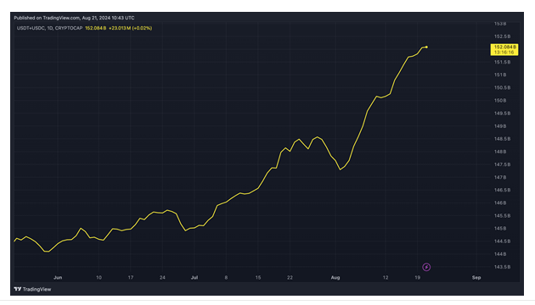
Introduction to Crypto

Slide 33
Introduction to Crypto
Tether’s Expansion Plan
Tether, the developer of the world’s largest stablecoin, said it plans to introduce a token pegged to the United Arab Emirates' dirham in collaboration with Abu Dhabi-listed crypto conglomerate Phoenix Group
Tether plans to seek licensing for the dirham stablecoin under the U.A.E. central bank’s Payment Token Services Regulation announced in June

Slide 34
Introduction to Crypto
34
What is Central Bank Digital Currencies (CBDC)?
Fiat money, tokenized (on chain)
CBDC are issued and controlled by governments; value fully determined by government monetary policy
Serve the same purpose as fiat
Offer advantages: availability, speed, cost savings
Contrary to cryptos and physical fiat, give government more control over your finances!

Slide 35
Introduction to Crypto
35
Stablecoin vs. CBDC
Easily confused with one another
Both are cryptos with value “around” fiat
2. Stablecoins are “private money” not under government control
Issuance process and value is not determined by government but by external mechanisms
That’s why the price fluctuates around fiat unit price and never equal, because control mechanisms are constantly at work
Pegging to fiat unit is just for convenience (units of account)
3. While most CBDCs are only in the research phase, stablecoins exist today

Slide 36
Introduction to Crypto
36
Stablecoin vs. CBDC (continued)
A clash between CBDC and Stablecoins is likely to emerge
CBDC feel more “familiar” and “secure” to public, at least initially
Stablecoins may have an advantage in innovation and flexibility. As private companies issue stablecoins, they may offer features that CBDCs cannot
Stablecoins can be used in decentralized finance (DeFi) applications, which allow users to access financial services without the need for traditional financial institutions
Both types of currencies can coexist and serve different purposes
CBDCs: everyday transactions and payments
Stablecoins: for niche applications such as DeFi

Slide 37
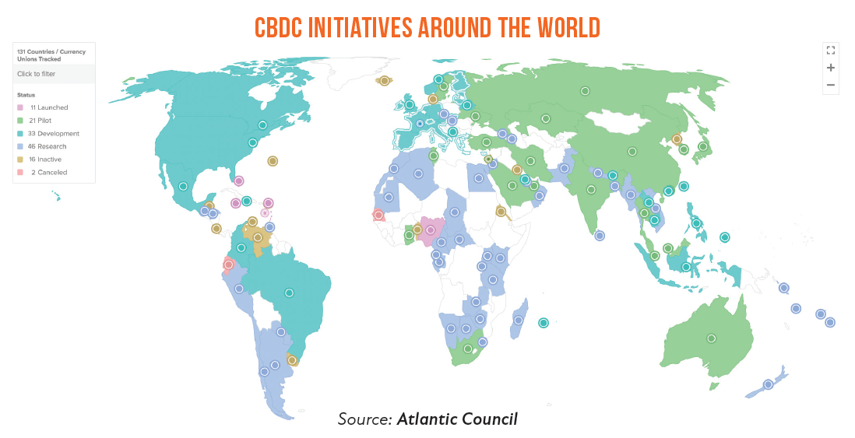
Introduction to Crypto

Slide 38
Introduction to Crypto
38
CBDC and Related Development
China: digital yuan (e-CNY)
Nigeria: e-Naira
Europe: digital euro
USA FedNow real-time payments system: the first step?
Australia: use case research
Colombia is working on digital peso
Payment institutions will need to differentiate themselves – CBDC or Stablecoins will offer a platform for new services.

Slide 39
Introduction to Crypto
39
Some summary thoughts
Understanding stablecoins is less about blockchain technology and more about how their unit value is maintained
We are living in the world of multiple chains and that will remain the case for the foreseeable future.
To ensure the coin ubiquity and usability, it needs to be present as an asset on multiple chains
Conversely, stablecoins can drive the underlying blockchain adoption!
The processes of stablecoin issuance is essential to understand price dynamics

